Slide 1
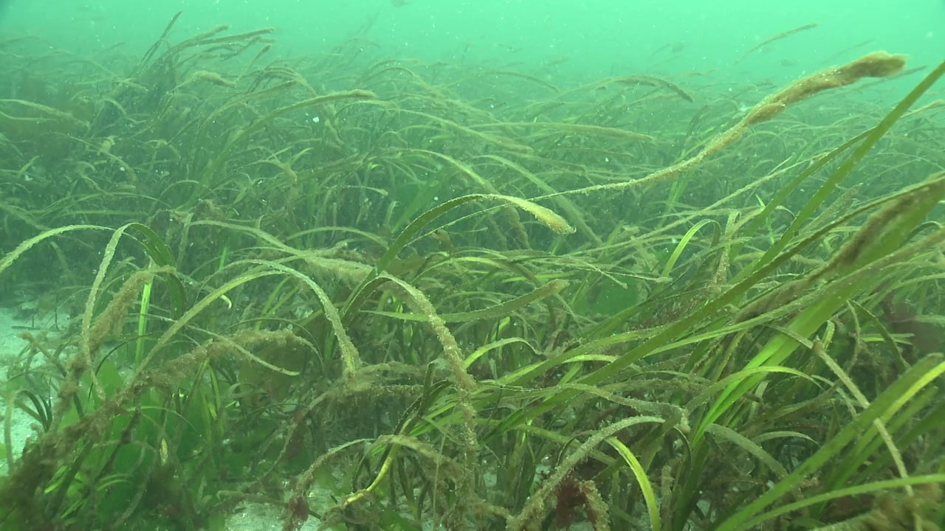
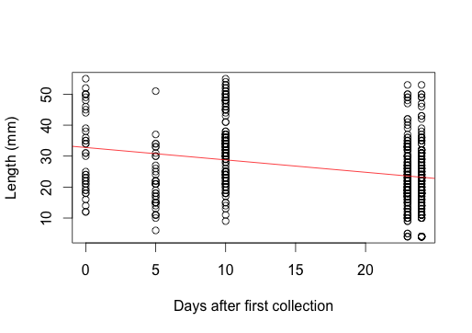
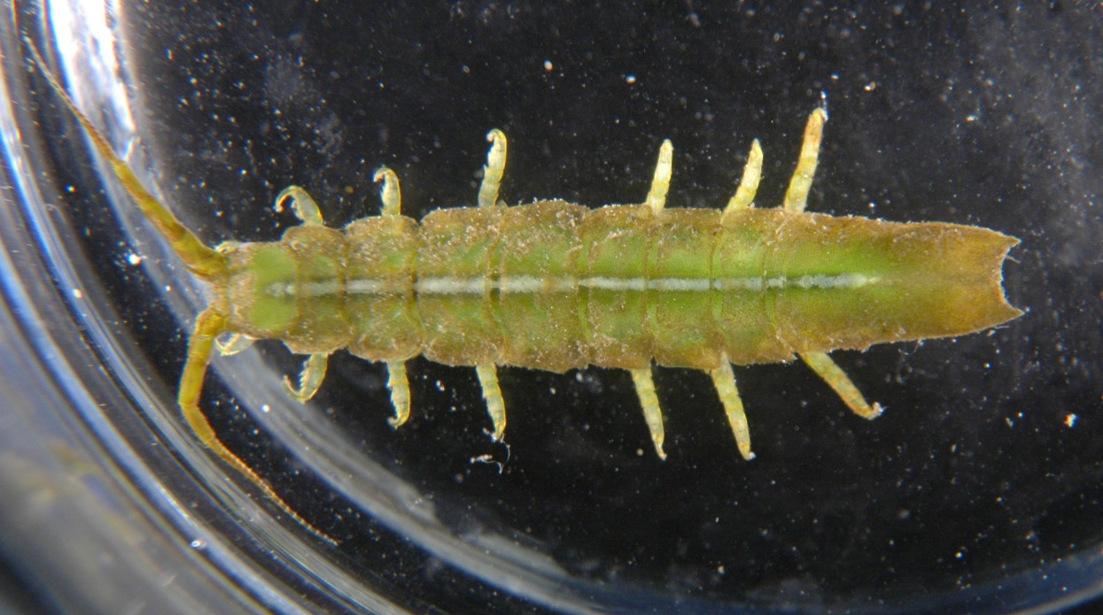
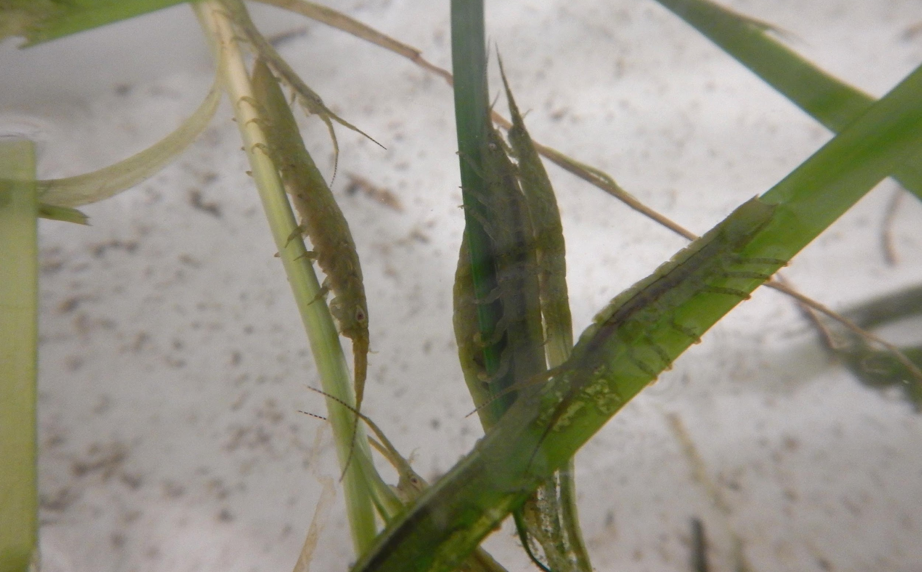
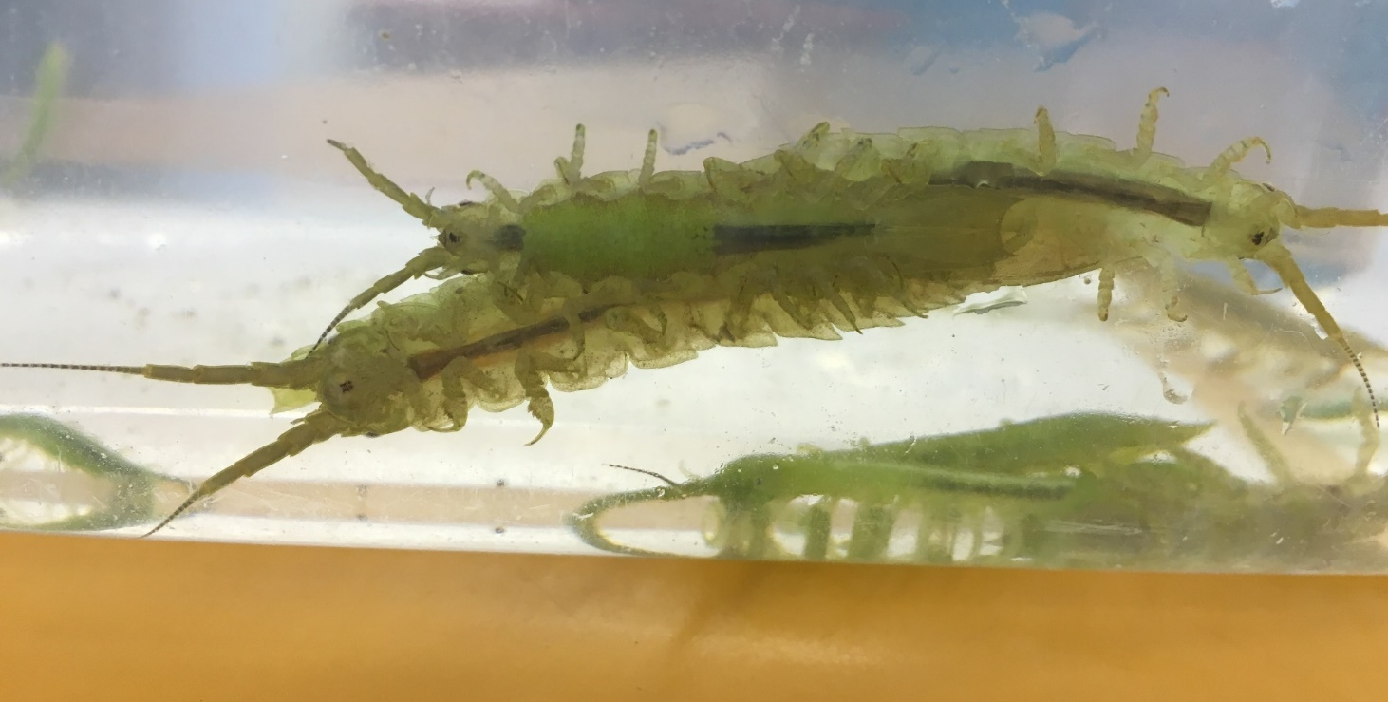
Where Do All the Isopods Go? A Population Study of Pentidotea resecata
Faith E. Hunnicutt, Sarah J. Anderson, and David L. Cowles, Walla Walla University, College Place, WA
Abstract
Results
The purpose of this study was to examine the eelgrass isopod Pentidotea resecata population throughout the summer to identify trends which may explain their winter disappearance. Population data were collected periodically during the summer of 2016 at the Padilla Bay National Estuarine Research Reserve; 580 individuals were caught in the eelgrass, measured, and returned. Our data show that the population has a multimodal distribution of body size which suggests the presence of multiple instars throughout the summer. They do not appear to have a terminal molt. Individuals of all sizes can be found throughout the summer, but not in the same ratios. The largest individuals were rarely found in the late summer when the population began to decline. Individuals appeared healthy and active throughout the summer. These results suggest that the disappearance of the isopodsis not due to mass death or dormancy in Padilla Bay, but may be due to migration.
We found individuals of all size classes during every collection period throughout the summer (Figure 8). Individuals of the population did not increase in average size throughout the summer as would be expected if they were part of a single cohort (Figure 5), and the largest individuals were present all summer long (Figure 9). Furthermore, many male individuals in the population exceeded the maximum length of 4 cm reported in the literature for the species (Kozloff, 1983, Lamb & Hanby, 2005). The population structure exhibited many size peaks (Figure 6), suggesting the presence of multiple instars. Separating the population by sex revealed that males grow considerably larger than females do, and that both sexes continue to molt after maturity (Figure 7). Adult males typically cling to adult females, holding them under their ventral side (Figure 3). Near the end of the summer the largest size classes become less common (Figure 8), then all size classes become scarce. We hypothesize that multiple size classes colonize the eelgrass early in the summer, thrive while living there, and relocate in mid-August, starting with the larger males, to a better winter habitat – possibly deeper or farther out into the Pacific.
Introduction
The marine isopod Pentidotea resecata (Figure 1) is usually bright green in color and blends in well with its preferred habitat and food source, Zostera marina eelgrass, in Padilla Bay, WA. P. resecata grows by molting and can be identified by their unique concave pleotelson. Strangely, no individuals are found for most of the year but are abundant on the eelgrass from late June to mid-August. Their numbers start to decline in late August, and eventually they completely disappear. The purpose of this study was to examine the P. resecata population throughout the summer to identify trends which may explain their winter disappearance.
Figure 5. Change in average size of animals throughout the summer. Red line indicates linear regression (p value 4.133e-13).
Figure 6. The distribution of sizes had a multimodal distribution, with a regular series of peaks suggesting the presence of multiple instars.
Figure 7. Plotting size separately by sex shows that males get larger than females and both sexes continue to grow and molt after maturity.
Figure 8. Distribution of sizes for all complete population samplings throughout the summer.
Figure 9. The maximum sized individual for each collection date through the summer. The largest sizes are present all summer long.
Figure 1. A male Pentidotea resecata, 5 cm long, found clinging to eelgrass in Padilla Bay.
Figure 2. Several individuals in their normal position clinging to eelgrass in running seawater tanks at RBML
Methods
Conclusions
During June to August 2016 580 Pentidotea resecata individuals from all size classes present were retrieved from shallow Z. marina beds in Padilla Bay (March Point area) near Anacortes, Washington. Animals were collected by wading and hand net netting at low tide or by towing a plankton net behind a boat at high tide. Specimens were transferred to running seawater tanks at Rosario Beach Marine Laboratory (RBML) (Figure 2), where they were counted, length was measured, and their sex and stripe color noted shortly after capture (Figure 3).
Population structure suggests that a multi-instar population of these isopods migrates to the shallow eelgrass in early summer, then leaves in late summer. Their location for the rest of the year is unknown.
The species grows larger than previously thought, and males grow larger than females.
Growth, molting, and reproduction continue the entire time the population is found in the eelgrass.
In late summer the older instars may either leave earlier or die off at a greater rate than younger instars.
Stripe color is not determined by sex, as previously thought.
Further Study
We need more isopods collected over a wider time frame to obtain a greater understanding of the population fluctuations in P. resecata. Red gut material was found in the late June early July time frame – was it just different plants growing because of the season or were the isopods migrating and eating the food at a different source?
Figure 3. The large adult males spent much of their time clinging to the somewhat smaller adult females, which they held on their ventral side as shown here.
Figure 4. Measuring an individual at RBML.
Acknowledgements
References
Our sincere thanks to Leah Dann and Judelle Johnson for help collecting isopods and access to their data, to Brandon Pierce for more help collecting isopods, to the Walla Walla University Biology Department for supporting this research, and to the Rosario Beach Marine Laboratory for providing the facilities.
Cowles, D. (2012). Pentidotea resecata. Retrieved August 1, 2016, from https://inverts.wallawalla.edu/Arthropoda/Crustacea/Malacostraca/Eumalacostraca/Peracarida/Isopoda/Valvifera/Family- Idoteidae/Idotea_resecata.html
Cowles, J. (2015). Does Photosynthesis Take Place in the Gut of Pentidotea resecata? M.S. thesis, Walla Walla University.
Kozloff, E., & Price, L. (1996). Marine invertebrates of the Pacific Northwest. Seattle: University of Washington Press.
Lamb, A., & Hanby, B. (2005). Marine life of the Pacific Northwest: A photographic encyclopedia of invertebrates, seaweeds and selected fishes. Madeira Park, BC: Harbour Pub.
Lee, W., & Gilchrist, B. (1972). Pigmentation, color change and the ecology of the marine isopod Idotea resecata. Journal of Experimental Marine Biology and Ecology, 10(1), 1–27.
Morris, R. H., Abbott, D. P., & Haderlie, E. C. (1980). Intertidal invertebrates of California. Stanford, Calif: Stanford University Press.

