Slide 1
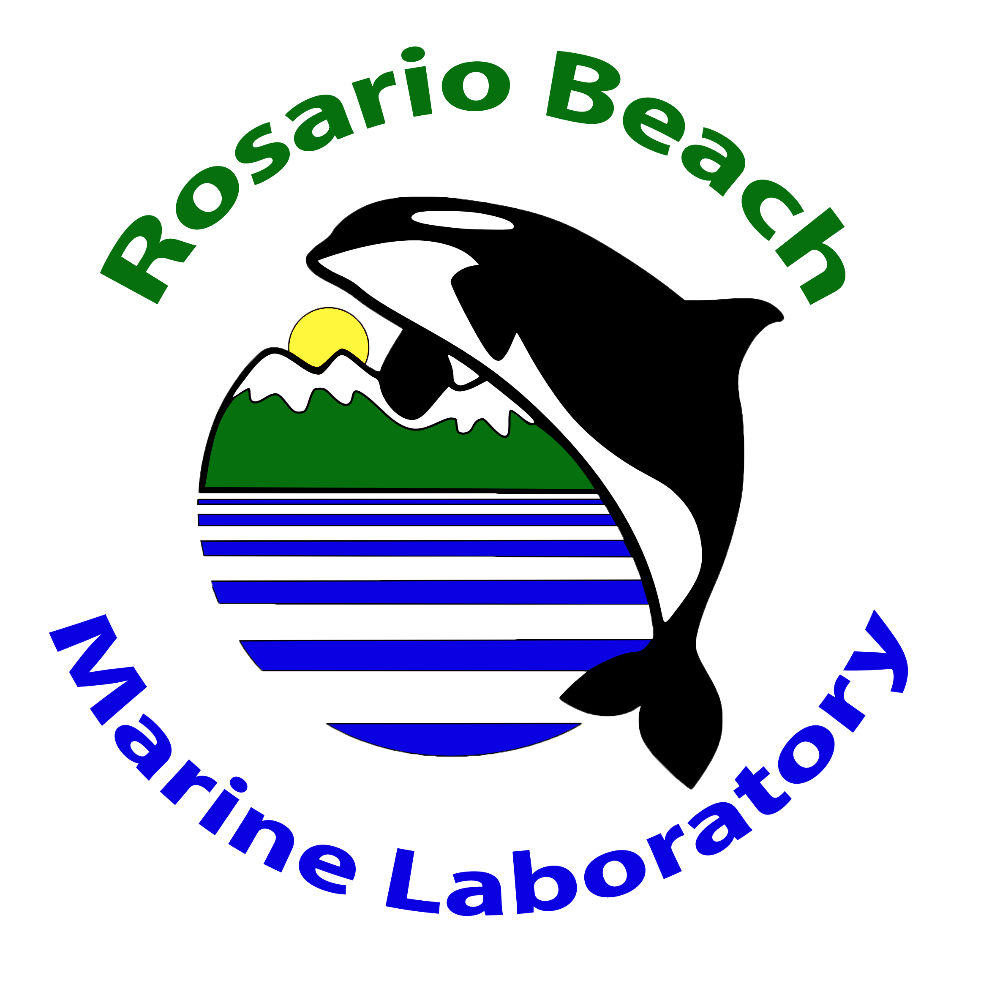
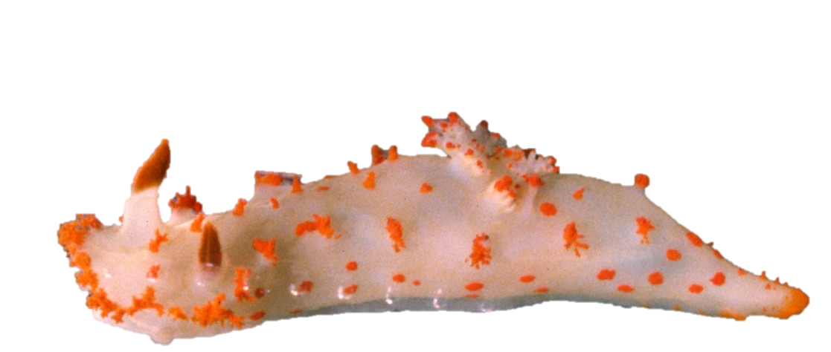
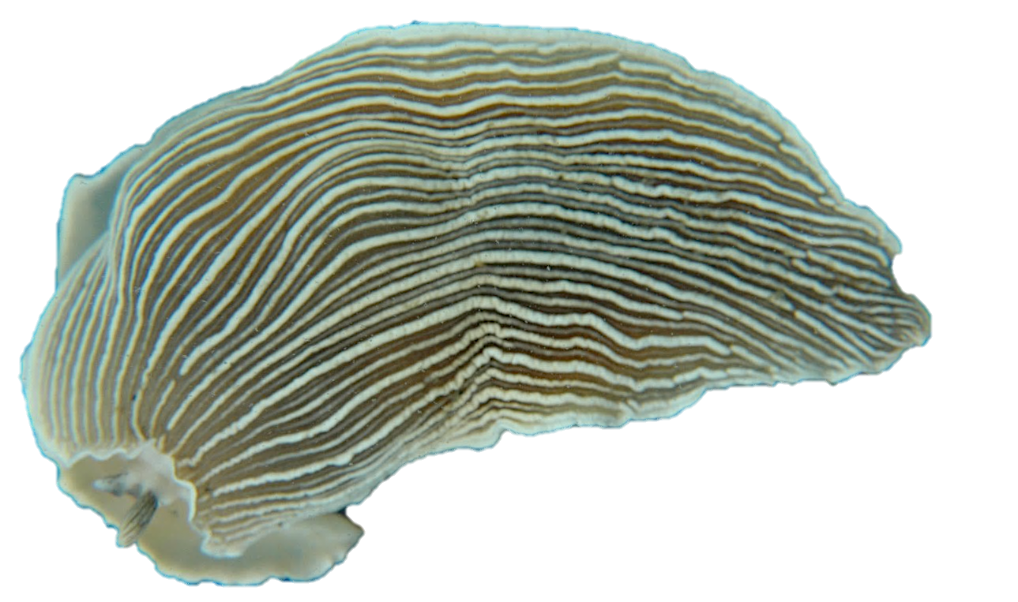
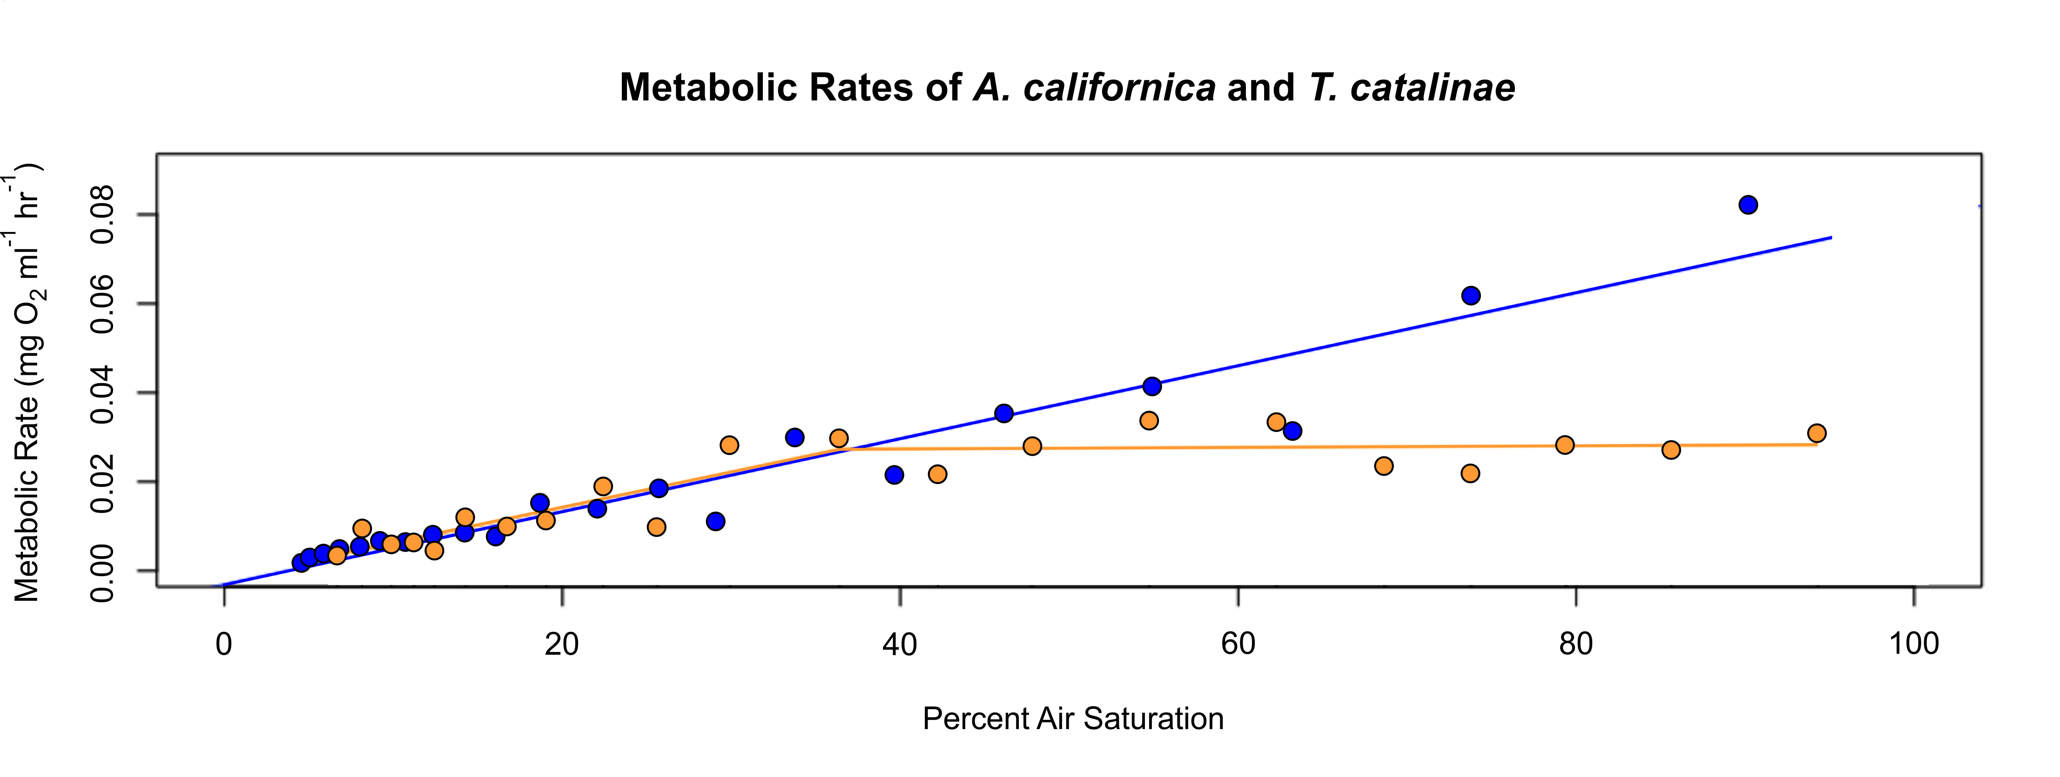
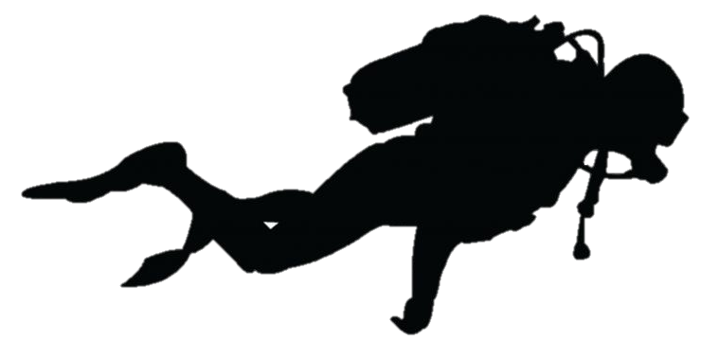
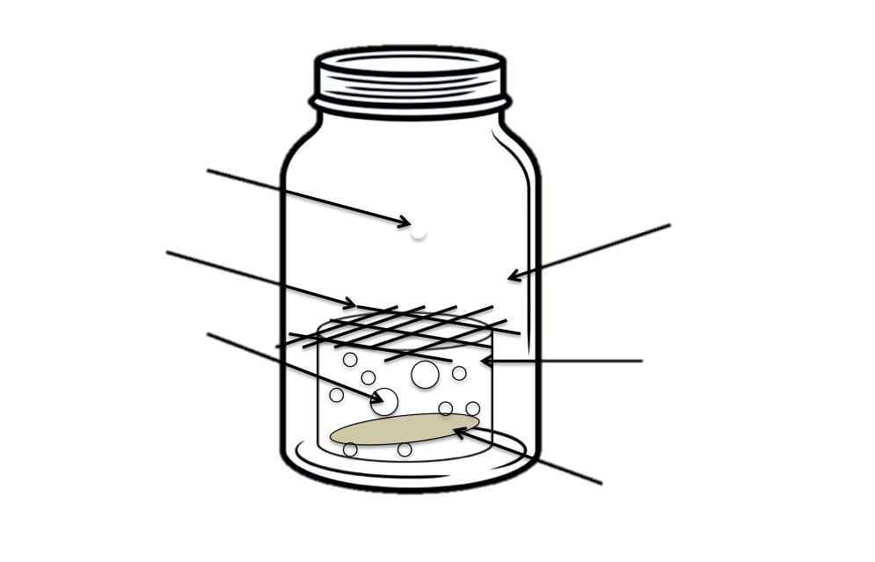
Two Nudibranch’s Oxygen Consumption Patterns Reflect Their Very Different Lifestyles Barbara J. Kiers, Luke E. Thomas and David L. Cowles
Results
Triopha showed a classic pattern of moderate oxyregulation (Fig.3), with a P_{c}O₂ of 36 and a regulation index of 82. Metabolic rate of Triopha above its P_{c}O₂ did not decline significantly with O₂ level . Contrary to expectations, however, Armina was an almost complete oxyconformer (Fig.3) with no clear P_{c}O₂ and a regulation index of only 51. However, Armina survived low oxygen levels better than did Triopha (Fig.4).
Fig.1: Triopha catalinae
Fig.2: Armina californica
Introduction
Conclusions
Oxygen, as the final electron acceptor for catabolic energy production, has a powerful effect on metabolism. Although anaerobic metabolic pathways exist, they are dramatically less efficient for supplying metabolic energy to an organism and often also produce toxic by-products. Virtually all animals preferentially use oxygen if it is available, and generally have physiological and behavioral mechanisms to ensure its delivery to their tissues (Wu, 2002). Many active marine species oxyregulate to maintain fully aerobic respiration down to the lowest oxygen values they encounter in their environment (Cowles et al., 1991). Exposure to truly zero environments, however, may require a different approach.
In this study we compared the oxyregulation capacities of two Pacific Northwest nudibranchs of similar size which have very different lifestyles. Triopha catalinae (Fig.1) is generally found in rocky areas where it feeds on bryozoans (Morris et al., 1980). Its environment typically has high oxygen tension and it has external gills to enhance oxygen uptake. Armina californica (Fig.2), on the other hand, lives on soft bottoms and consumes sea pens (Morris et al., 1980). It spends much of its time burrowed under the sediment where it likely experiences hypoxia. Although it does have gills, they are simple lamellae under a mantle fold instead of extending out into the water as do those of Triopha. We hypothesized that Armina is routinely exposed to lower oxygen levels than T. catalinae is and that it therefore would have a stronger oxyregulatory capacity.
The Metabolic Rate graph (Fig. 3) shows Armina to be an oxyconformer due to the straight line (p of slope = 4.64x10⁻¹²); whileTriopha is an oxyregulator due to the rapid drop at 30% (p of slope >30% saturation = 0.98; p = 0.028 < 30%)
Even though Armina does not oxyregulate, its survival at low oxygen is better than that of Triopha (Fig. 4).
We conclude that Armina experiences such low oxygen levels in the sediment that its metabolism is specialized for anaerobic survival rather than for maximizing oxygen extraction efficiency.
Further research could include comparing patterns for other nudibranch species such as Dialula sandiegensis or Cumanotus beaumonti which may also experience oxygen limitation.
Fig 4:Survival rates for individuals of each species. Note that Triopha were not always exposed to zero O₂.
Fig.3: Calculated metabolic rates for both species of nudibranch as a function of oxygen percent air saturation. There is a clear difference, with Armina having the classic linear correlation characteristic of oxyconformity and Triopha oxyregulating down to a P_{c}O₂ at 36% saturation.
Methods
Measure aerobic metabolism of each animal in a sealed chamber using FireStingO2 system
Analyze rate of aerobic metabolism as a function of oxygen level.
Calculate P_{c}O₂ and regulation indices
Relevant Literature
Cowles, D. L., Childress, J. J., & Wells, M. E. (1991). Metabolic rates of midwater crustaceans as a function of depth of occurrence off the
Hawaiian Islands:Food availability as a selective factor? Marine Biology, 110(1), 75–83. doi: 10.1007/bf01313094
Morris, R. H., & Abbott, Haderlie, E. C., D. P. (n.d.). Intertidal invertebrates of California. Stanford, CA: Stanford Univ. Press.
Mueller, C. A., & Seymour, R. S. (2011). The Regulation Index: A New Method for Assessing the Relationship between Oxygen Consumption and
Environmental Oxygen. Physiological and Biochemical Zoology, 84(5), 522–532. doi: 10.1086/661953
Muggeo, V. M. R. (2003). Estimating regression models with unknown break-points. Statistics in Medicine, 22
Pickton, B. E. (1991). Cumanotus beaumonti (Eliot, 1906), a nudibranch adapted for life in a shallow sandy habitat?
Wu, R. S. (2002). Hypoxia: from molecular responses to ecosystem responses. Marine Pollution Bulletin, 45(1-12), 35–45. doi: 10.1016/
s0025-326x(02)00061-9
Fire Sting Dot
Mesh Covering on top of pipe
Jar
At least 12 hours/experiment
Acknowledgements
Different sized holes drilled into pipe
1 ½ diameter pipe cut one inch tall
We would like to acknowledge the support of Rosario Beach Marine Laboratory and all the individuals who helped to make this project possible. A special thank-you to Dr. Lloyd Trueblood for the use of his FirestingO2 device, and Dr. Kirt Onthank for the sensor dots that he donated to the project. We would also like to thank the dive team at Rosario in the assistance of acquiring the specimens for the project. None of the research would have been possible without your help. Thank-you.
Collect 10 individuals of each species
Magnetic Stir bar (added part way though experiment to enhance accuracy)
O₂ declined from near air saturation to near zero in each experiment

