Slide 1
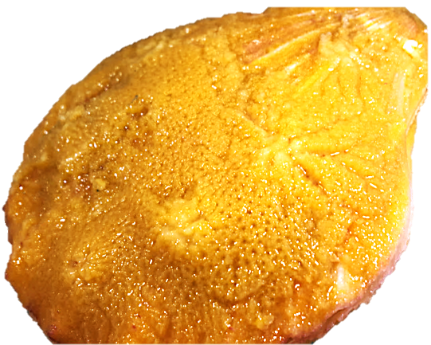
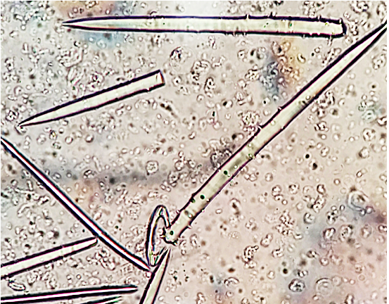
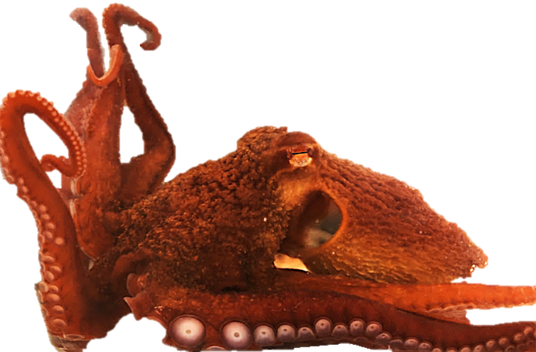
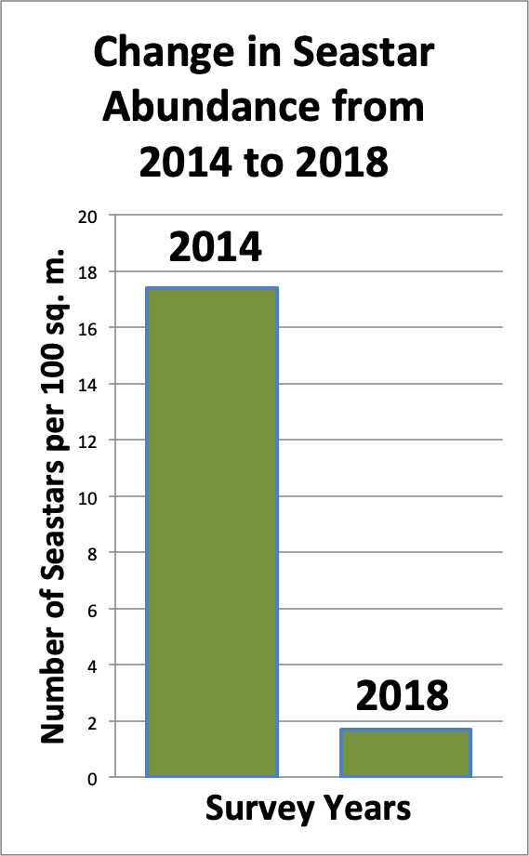
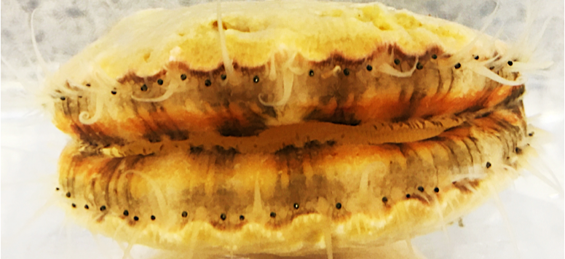
Jefferson W. Humbert, Dustin J.E. Gienger, David L. Cowles, Kirt L. Onthank
Rosario Beach Marine Laboratory, Walla Walla University
OCTOPUS PREDATION MAY BE RESPONSIBLE FOR
SPONGE-SCALLOP MUTUALISTIC BEHAVIOR
Abstract
Materials and Methods
Results
Discussion
Within the Salish Sea, spiny scallops (Chlamys hastata) are frequently encrusted with sponges. This behavior is traditionally believed to be a mutualistic relationship that protects the Scallops from sea star predation (Forester 1979). It has been largely accepted that sponge encrustation of scallop shells prevents starfish from gaining a sufficient grip on the scallop, allowing the scallop to safely swim away. ​
In this study, we observed a very small population size of seastars in the survey areas. Despite the small number of seastars, 93.5% of wild scallops were still found to have at least 60% of their shells covered with sponge. If sea star populations are in such low numbers, what is maintaining this sponge scallop mutualism? ​
Our research demonstrates that the Giant Pacific Octopus (Enteroctopus dofleini), a local predator which frequently predates scallops, is more than 7 times as likely to eat a scallop without sponge than a sponge-encrusted scallop if given a choice. This suggests that predation by octopus is also an important factor potentially selecting for the sponge-scallop relationship, and may currently be more important than predation by seastars. ​
Surveying for Seastar and Encrusted-Scallop Abundance
Three transects were conducted at depths between 12 m and 18 m on the western side of Northwest Island during July 2018. Each transect was 30 m long and 2 m wide. It was marked by a leaded line. Due to the disturbance to the motile scallops of setting up the leaded line, scallop data were recorded a day or more after the line was deployed so the area would be as undisturbed and as natural as possible. Transect data were taken for the number of scallops present, the percentage of sponge coverage on scallop valves, and the numbers and species of seastars present. Data for all specimens within 1 m of the transect line were recorded on slates by divers. ​
Quantifying Octopus Preference of Bare versus Encrusted Scallops​
Between July 23rd and July 31st 2018, three juvenile Giant Pacific Octopus (E. dofleini) were collected at Admiralty Bay, Washington. Octopuses were placed in large outdoor aquariums with a flow through seawater system located at Rosario Beach Marine Laboratory in Anacortes, Washington. Octopuses were acclimated to their environments for several days before trials began. During this period various crustaceans were provided ad libitum to ensure starvation would not impact scallop predation. ​
Rough scallops (C. hastata) were collected from Sares Head and the west side of Northwest Island, after transects were completed at these locations. Collected scallops were housed in a large aquarium with flow-through seawater and a full spectrum light system to ensure the health of the sponge encrusting the valves. Scallops were visually inspected for sponge encrustment coverage. To be considered encrusted the scallop valves were required to have at least 80% sponge coverage counting both valves (with the exception of the small byssal thread area near the hinge which almost never is encrusted with sponge). If scallops were found to have less than 80% of the valve encrusted they were “cleaned” with a wire brush to remove all traces of sponge. The cleaned scallops were then placed in the non-sponged category. ​
At the beginning of the trials, 10 scallops were placed in the individual seawater aquariums with each E. dofleini specimen. Each group of 10 scallops was composed of 5 sponge-free scallops and 5 sponge-encrusted scallops. The entire group of scallops was placed in the center of each aquarium and allowed to subsequently move independently around the aquarium (due to their ability to swim). The octopuses were able to eat to satiation due to their small size, and ate a daily average of 1 scallop. The shells of eaten scallops were removed and replaced with a live scallop from the same encrusted or sponge-free category, thus a 5:5 ratio of encrusted versus sponge-free scallops was always maintained. ​
Due to the small size and limited feeding ability of the three collected E. dofleini, a much larger 7 kg specimen was tested at the Bellingham Marine Life Center. In a 24-hour period, it was given 20 scallops from each category, to allow the octopus to feed to satiation. The following morning, dead scallop specimens were removed and counted.
In the 180 m² of our transects we found 62 scallops, 58 (93.5%) of which had at least 60% sponge coverage, counting both valves. 39 of these (62.9%) had over 80% sponge coverage (Figure 4). Average spatial density of the scallops was one scallop every 5.8 m². The only seastar species encountered was Evasterias troschelii (Stimpson, 1862), of which 3 individuals, or one every 120 m², was found.​This is over a 90% reduction in seastar abundance from a survey taken in 2014, during the seastar wasting disease epidemic (Table 1).
​During the test period a total of four Octopuses were experimented with. During their trial periods, which varied in length, they consumed a total of 67 scallops, 60 of which were sponged and 7 which were not sponged. From this data we calculated that a captive E. dofleini will preferentially consume non-sponged scallops over sponged scallops 89.5% of the time, when fed exclusively Chlamys hastata. The most dramatic demonstration of this was the 7.7 kg octopus Octane, who in one night consumed 16 scallops, 15 of which were unsponged. These data are shown in Figure 5.
Our data strongly support the idea that E. dofleini is an important driver of sponge-scallop mutualism. With the relative absence of seastars (over 90% reduction since the seastar wasting disease) witnessed in the transects, predation pressure by seastars is likely to be greatly attenuated.
​
E. dofleini has been shown to have an substantial prey preference, choosing to consume non-sponged scallops 89.5% of the time (chi-square test, p value< 0.0001). This could indicate that, for a scallop, it is highly advantageous to cultivate a mutualistic relationship with sponges when octopuses are present.
​
We believe that seastars prey on scallops with neither the same speed nor quantity that an octopus would. A small, slow moving sea star would not be as successful as a large octopus which, depending on its size, could eat a large number of scallops.
​
In our study we demonstrated the natural abundance of sponge encrusted scallops, despite the lack of seastars around Northwest Island. We also documented the predatory behavior preference of E. dofleini, for bare scallops as well as gathering preliminary data on how many scallops a healthy E. dofleini would need for normal growth. ​
It appears that octopus are an important selective factor for sponge encrustment on scallops. Although seastars could be an important predatory part of the sponge-scallop mutualism, we have established that E. dofleini could be influencing this mutualism as well.
Figure 4, C. hastata sponge-encrustment percentages as determined from marine transect data conducted at Northwest Island.
Introduction
The scallop Chlamys hastata (Sowerby, 1842) (Figure 1) is an abundant and easily collected species in the Pacific Northwest’s Salish Sea. They are frequently found encrusted with the sponges Myxilla incrustans (Esper, 1805) (Figure 2) or Mycale adhaerens (Lambe, 1894). Classically, this relationship has been regarded as a mutualism that helps protect the scallop from predation by seastars (Bloom, 1975, Farren and Donovan, 2007). However, octopus also predate on scallops (Bloom, 1975; Onthank et al., 2012). Furthermore, seastars suffered very high mortality in the Salish Sea during the recent seastar wasting pandemic, yet the majority of scallops in the area continue to be encrusted by sponges (personal observation). ​
In this experiment we quantified the prevalence of seastars and sponge-encrusted scallops near Rosario Beach Marine Laboratory and tested the hypothesis that sponges help protect scallops from predation by Pacific Giant Octopus Enteroctopus dofleini (Wulker, 1910), a common, large octopus in the Salish Sea (Figure 3).​
Figure 5, E. dofleini feeding preference on sponged and non-sponged scallop categories during trial periods.
Figure 2, Spicules of encrusting sponges were analyzed and the Myxilla incrustans species was determined.
Acknowledgements
A special thanks to: Sarah Anderson and Jim Nestler for assisting with dive operations. The Bellingham Marine Life Center for the use of Octane, their octopus. Rosario beach Marine Laboratory for the use of their facilities and equipment.
Figure 3, Live specimen of E. dofleini used for experimentation.
Works cited
Figure 1, Live specimen of Chlamys hastata encrusted with Myxilla incrustans.
Bloom, S. A. (1975). The motile escape response of a sessile prey: A sponge-scallop mutualism. Journal of Experimental Marine Biology and Ecology,17(3), 311-321. doi:10.1016/0022-0981(75)90006-4
Donovan, D., Bingham, B., Farren, H., Gallardo, R., & Vigilant, V. (2002). Effects of sponge encrustation on the swimming behaviour, energetics and morphometry of the scallop Chlamys hastata. Journal of the Marine Biological Association of the C.R. Pitcher, A.J. Butler, Predation by asteroids, escape response, and morphometrics of scallops with epizoic sponges.
Onthank, K. L., Payne, B. G., Groeneweg, A. R., Ewing, T. J., Marsh, N., Cowles, D. L., & Lee, R. W. (n.d.).A sponge-scallop mutualism may be maintained by octopus predation. Clean Manuscript,1-29. Retrieved August 12, 2018.
Dann, L. and H. Ito, 2014. Comparing seastar, prey, and wasted individual counts on the protected side and exposed side of Coffin rocks, Fidalgo Island, WA. Unpublished report for Rosario Beach Marine Laboratory Marine Invertebrates class.
Table 1: Change in Seastar abundance from 2014-2018. The 2014 data are from Dann and Ito (2014). At the time of the 2014 survey Pycnopodia helianthoides had already suffered nearly 100% mortality from wasting disease.

