Slide 1
BIOL 419 Field Studies: Sea of Cortez
March 22-30, 2018

Slide 2
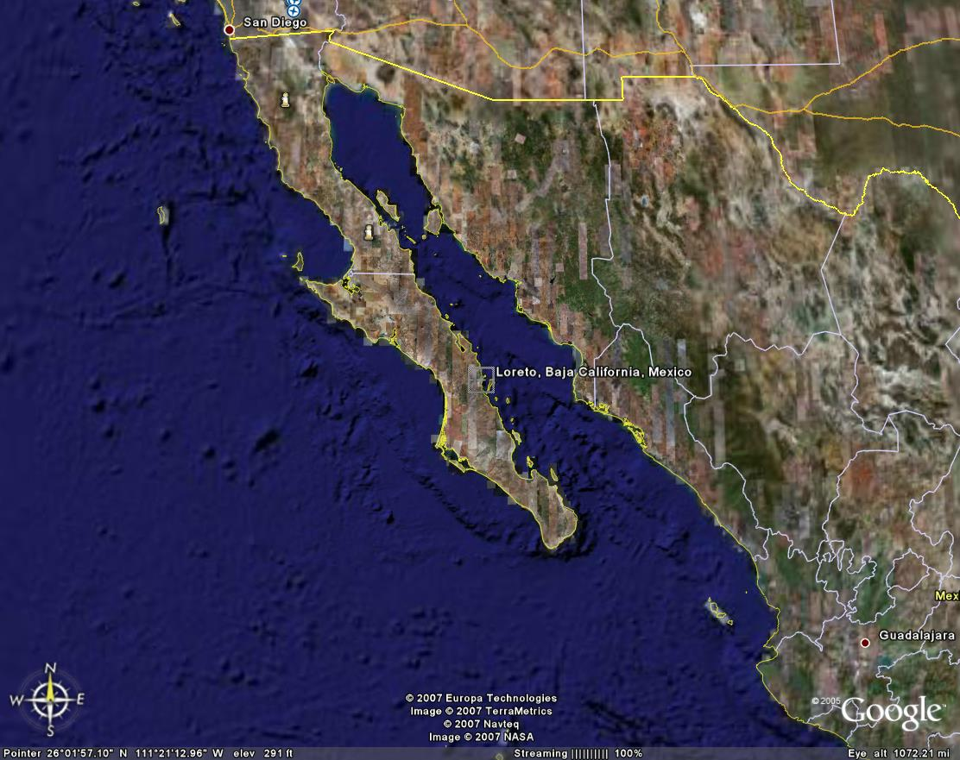
2 Credits Upper-division Biology
Spring vacation + several evenings
Camp on beach, study sea/desert
Grading:
Attendance + quizzes
Participate in trip (log)
Poster

Slide 3
Tentative Itinerary:
Thu Mar 22 Fly to Loreto
Fri Mar 23 Snorkeling checkout/snorkel
Sab Mar 24 Explore sea/desert
Sun Mar 25 Travel to Bahia de Los Angeles
Mon Mar 26 Snorkeling, wildlife
Tue Mar 27 Travel to Scammon’s Lagoon
Wed Mar 28 Whales, San Ignacio, Bahia Concepcion
Thu Mar 29 Return to Loreto
Fri Mar 30 Fly home

Slide 4
Costs (estimated):
Covered:
Not Covered:
Tuition: $1476
Fees: $91
Total: $1567+
(standard tuition for 2 credit hours = $1476)
Camping fees
Car:
Rentals
Insurance
Fuel
Boat charters
Entrance fees
2+ meals/day
Medical/Evacuation insurance
State fees
Plane ticket
Camping supplies
(Extra meal)
SCUBA fees
Spending money
Bag fee*
$250 deposit required by Dec 13 (counts toward total)
Costs must be paid in advance.
Alaskaair.com Studentuniverse.com Bookingbuddy.com kayak.com

Slide 5
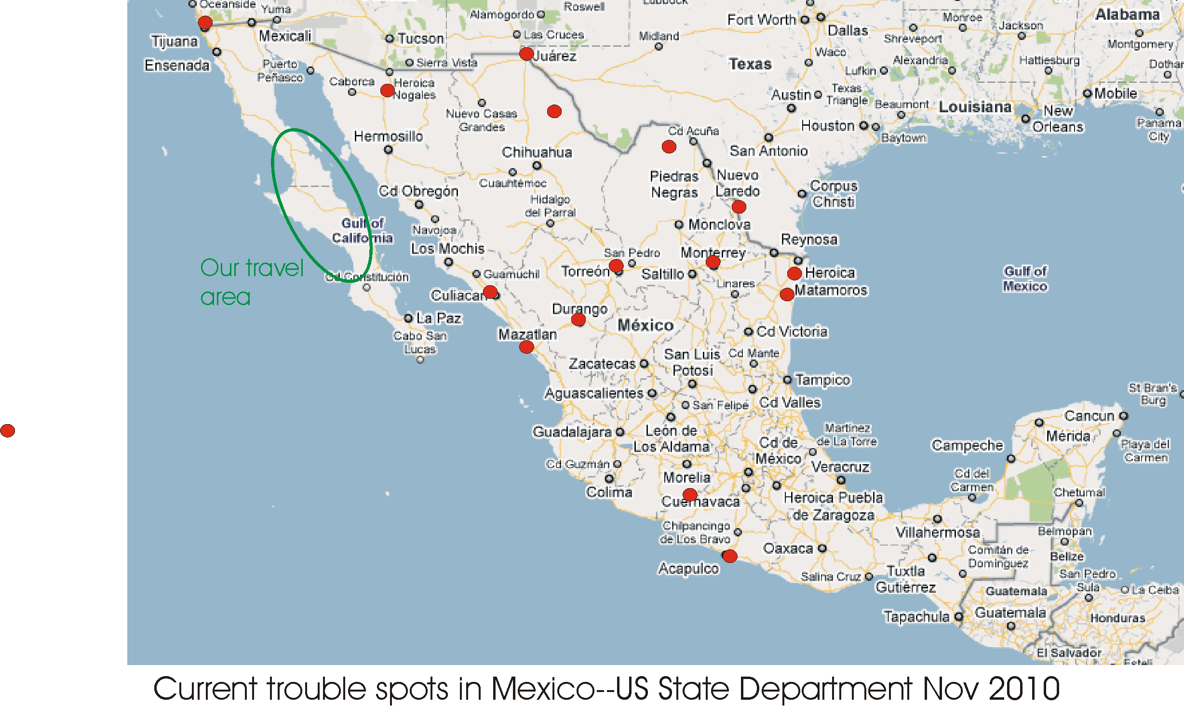

Slide 6
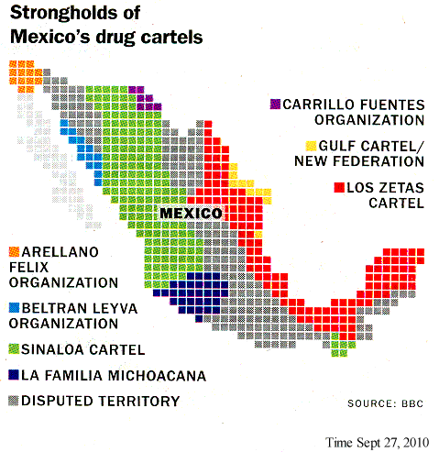

Slide 7
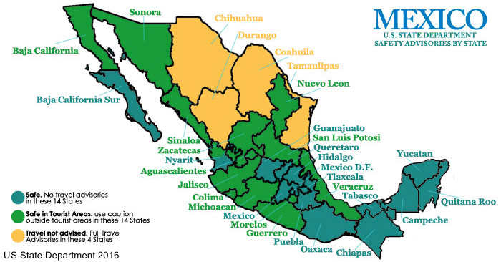
Our Area

Slide 8
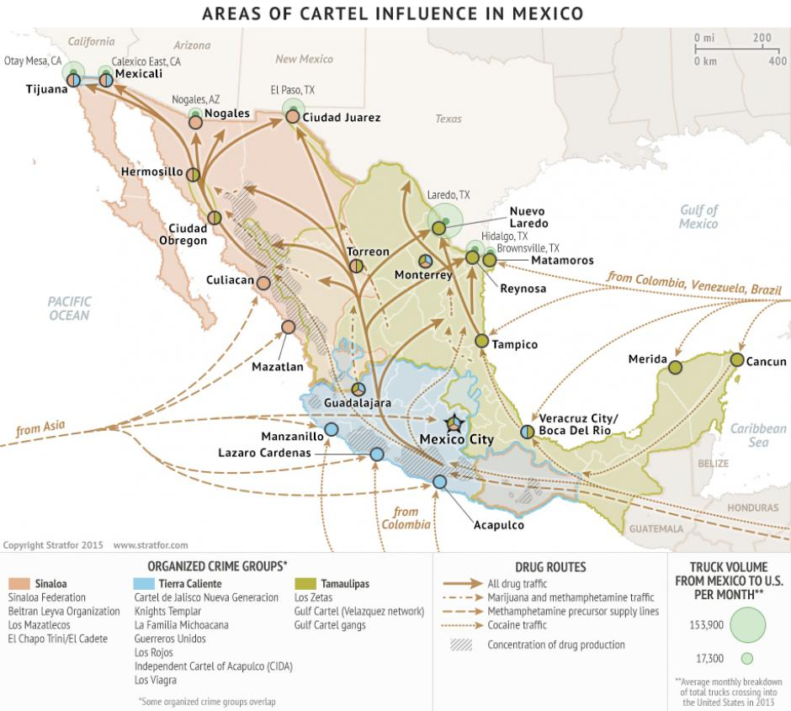
Our Area
Forbes, Jan 15, 2015

Slide 9
Safety Precautions:
Cell phones (Near towns, with SIM chip)
Satellite phone
Keep valuables, passport with you
Waterproof bag
Emergency evacuation insurance
Group activities

Slide 10
Bring:
Passport
Light camping gear:
light sleeping bag
small tent with mosquito netting (must have or share a tent)
Sleeping pad
Flashlight
Simple camera
Binoculars
Bird books
Spanish/English dictionary
Toiletries, medicines
Clothes for warm/cool weather
Walking shoes/sandals
Snorkeling gear:
Mask/fins/snorkel
Wetsuit (need shade/warmth)
Swim suit/towel
Wading shoes
Sun block
Sunglasses
Water bottle
Wide-brimmed hat

Slide 11
What to do ASAP:
Fill out the interest/contact information sheet
Talk to your parents, get their approval
Make sure you have a valid, up-to-date passport through 2018
Pay $250 earmarked deposit at Student Finance(and let me know)
See Nancy Cleveland in Student Finance
If you decide later not to go, let me know ASAP.
What to do as soon as you get clearance from me:
Register for class via signed ‘Change of Registration’ form
Buy airline ticket (we should fly together if possible, 3 minimum)
Let me know your flight itinerary
See Student Health Services, tell them of this trip
For more information consult the class web page:
https://people.wallawalla.edu/~david.cowles/Class_Materials/Sea_of_Cortez/Field_Studies-Sea_of_Cortez.html
Or link to it from:
inverts.wallawalla.edu

